Slide 1
PI Safe eCommerce
Site Storyboard

Slide 2
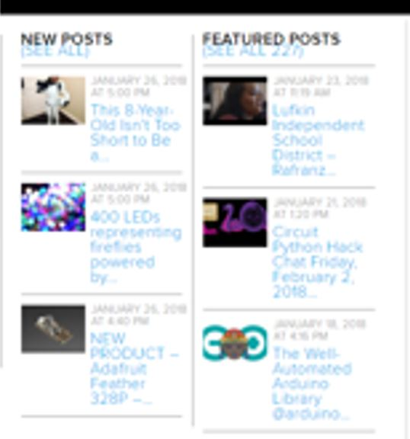
Cart
Amazon Affiliate Process
PR111
Raspberry PI Zero (2)
Wifi Adaptor (1)
Sensor
Arduino board
Order Placed
Customer orders a project as a single package
Package items pass through using affiliate plug-in
Customer notified order went through

Slide 3
PI Safe Categories
Store is driven by posts
Each post presents a project
Video and Instructions
Each post comprises a list of materials
Each post has a cart ID
A cart ID may have multiple products
WooCommerce store front shows a cart NOT individual products
When a cart is ordered, a backend transaction passes through to Amazon / Alibaba as a combined order
Featured Posts
Bitcoin Mining
iGarden
New Posts
Author A – Use of …
Author B – IoT
Categories
Coding Projects
Wearables…

Slide 4
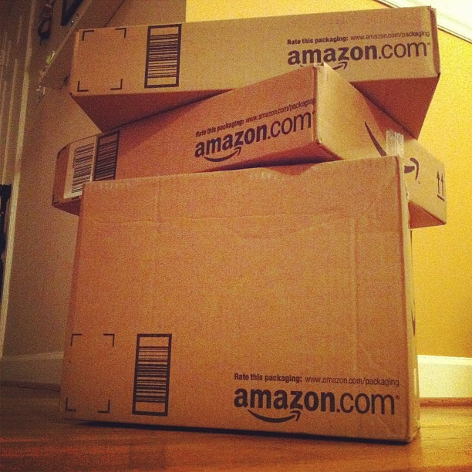
Affiliate Schema
Project | Pack ID
BC Miner | M004
Smart Garden | G003
Mobile VPN | V004
Posts of IoT projects
Include a shopping cart of the materials used. A single pack may contain multiple components. Pack ID M004 sends an order for 4 items to Amazon
Pack ID | Comp 1 | Comp 2 | Comp 3 | Comp 4
M004 | PI Zero | BC USB | Case | Power
G003 | PI Zero | Sensor | Case
V004 | PI B+ | WIFI Chip | Antenna | Power
Order 4 items to 123 Main St

Slide 5
Training Resources
Adding affiliate products

